Slide 1


Git Workshop
R33S

Slide 2
Outline of Workshop
What is git? Why do we need it?
Git Architecture and Folder Structure
Basic workflow
Branches
Basic merging
Remotes

Slide 3
What is Git
Git is a free and open source distributed version control system (VCS).
designed to handle everything from small to very large projects with speed and efficiency.

Slide 4
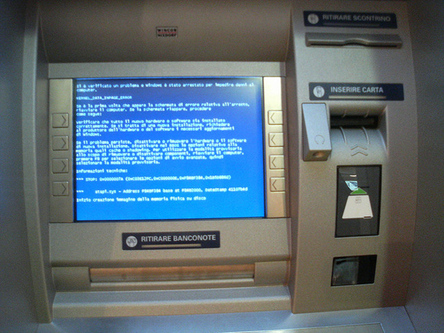
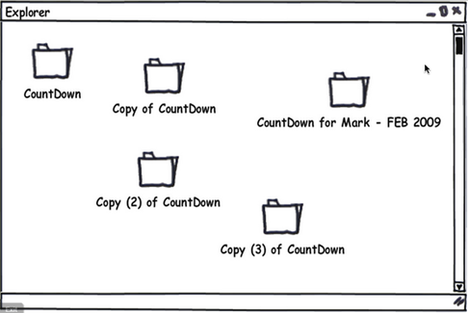
Why do we need it

Slide 5
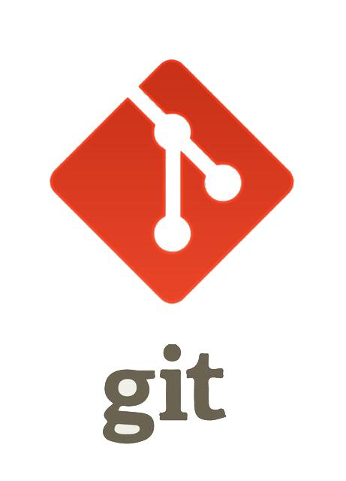
VCS will handle it
A good VCS has to:
Prevent data loss
Provide history of who did what
Allow commit messages
Ease the creation of patches
Be fast and scalable

Slide 6
Again About Git
Git is distributed – (almost) everything is local – you can work offline and have backups on your local machine
Git is fast – again, most of your work is local, and network interactions are compressed and minimal
Git stores snapshot- making everything small

Slide 7
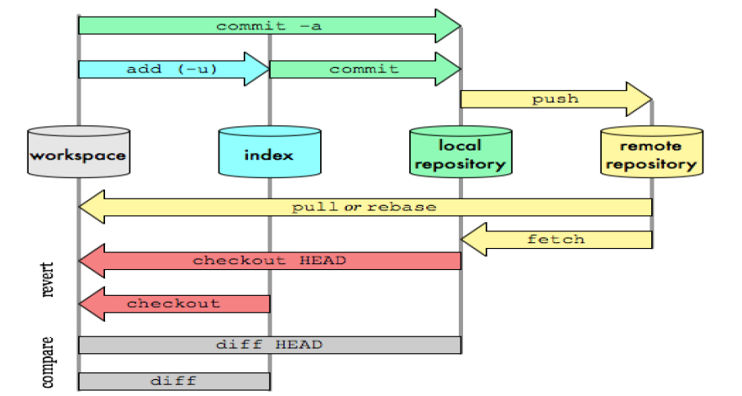
Git Architecture

Slide 8
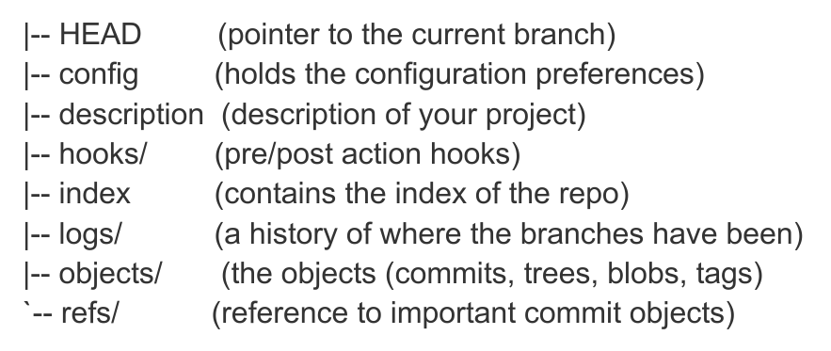
.git Folder Structure

Slide 9
Git Basics commands
git init git log git remote
git clone git diff git pull
git config git revert git push
git add git reset
git commit git branch
git status git merge

Slide 10
Git Workflow
At the beginning of work with Git we are creating empty repository (or cloning an existing one)
Repository

Slide 11
Git Workflow
During our work, we are modifying file structure inside a Working Tree
Repository
Working
Tree

Slide 12
Git Workflow
Changes from the working tree are not registered in the repository directly. Instead, they are registered in the Index/staging area.
Repository
Working
Tree
Changes to the working tree are registered in the index using
Index
git add

Slide 13
Git Workflow
Once the index contains everything you want to commit, you record the changes in the repository
Repository
Working
Tree
Changes are commited to the repository from the state of the index using
Changes to the working tree are registered in the index using
Index
git commit
git add

Slide 14
Git Workflow
Earlier states of the working tree may be checked out from the repository at any time using
Repository
Working
Tree
Changes are commited to the repository from the state of the index using
Changes to the working tree are registered in the index using
Index
git commit
git add

Slide 15




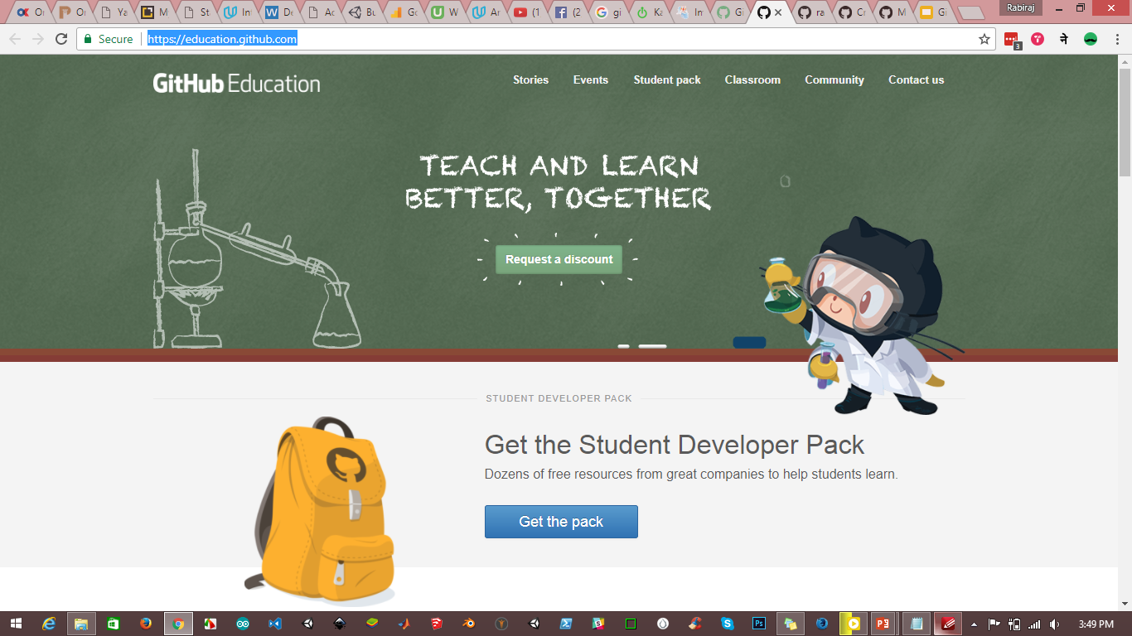










GitHub for Student
https://education.github.com/pack

Slide 16
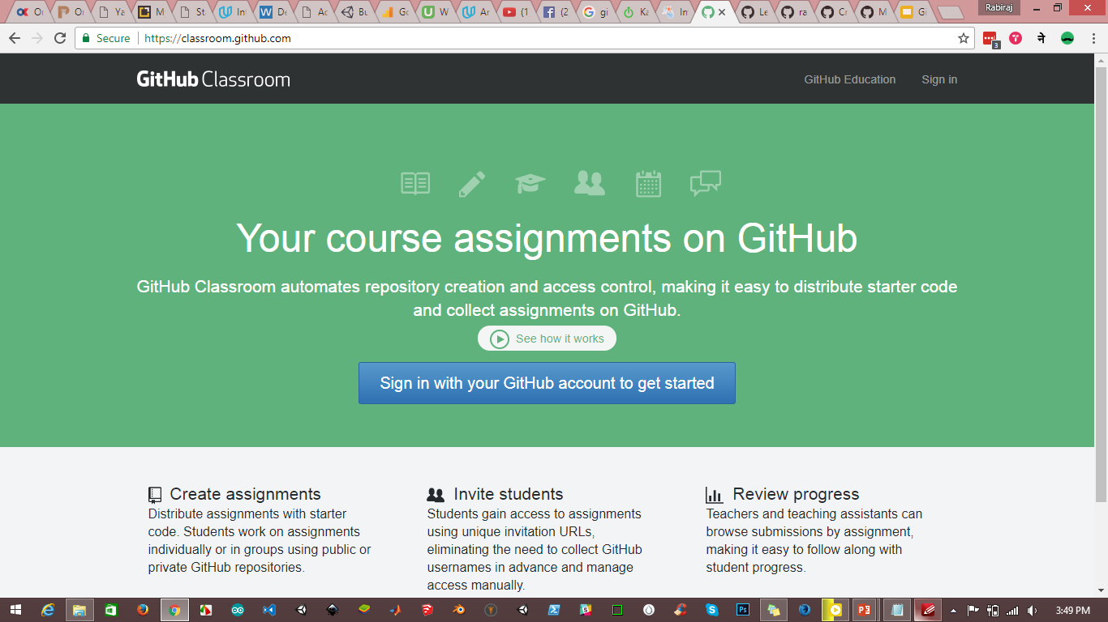
GitHub for Teachers
https://classroom.github.com/

Slide 17
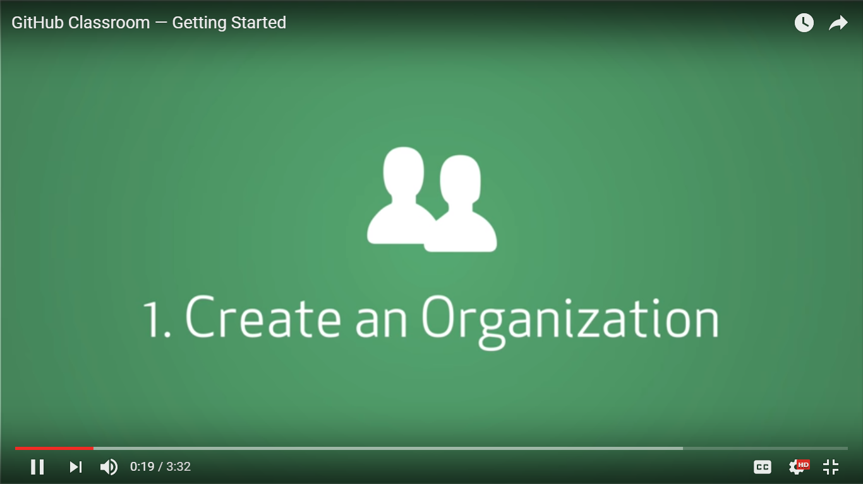
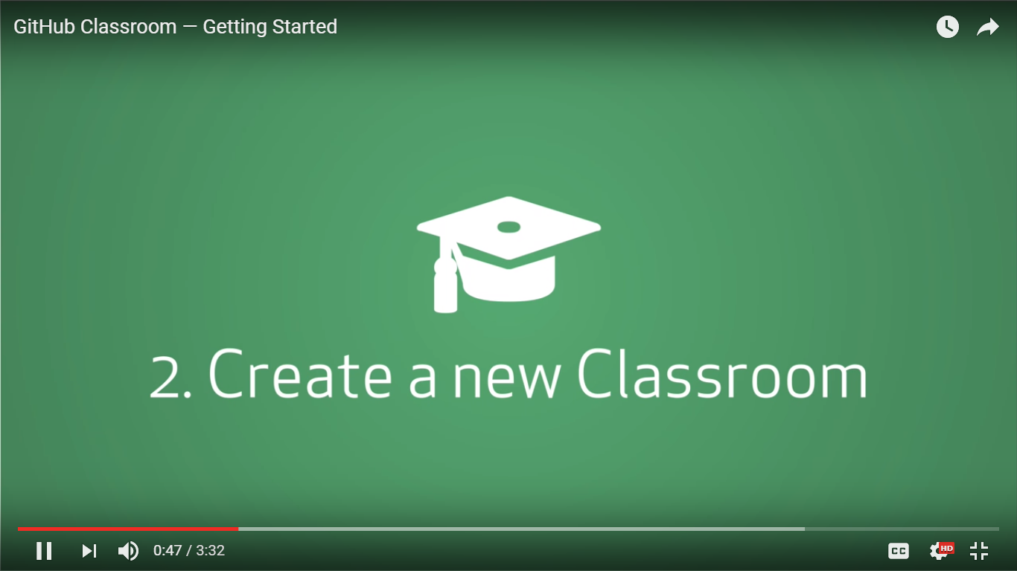
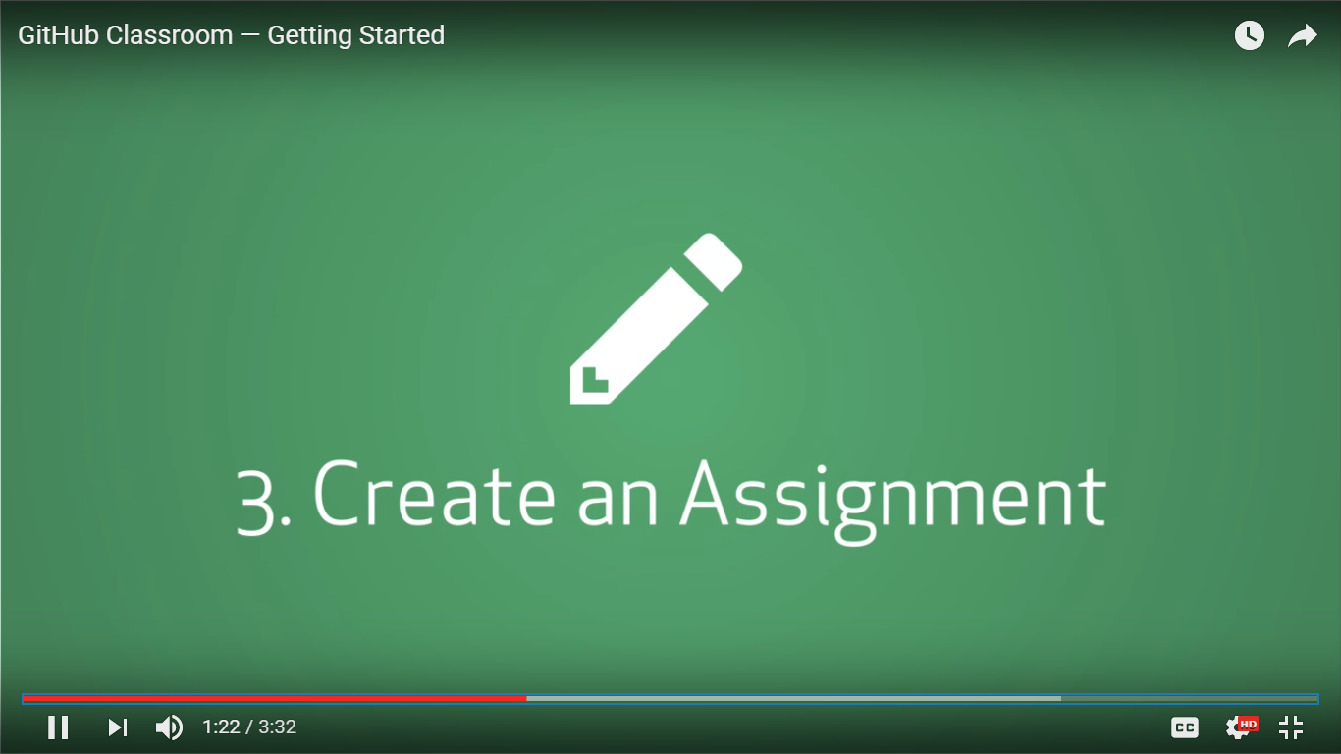
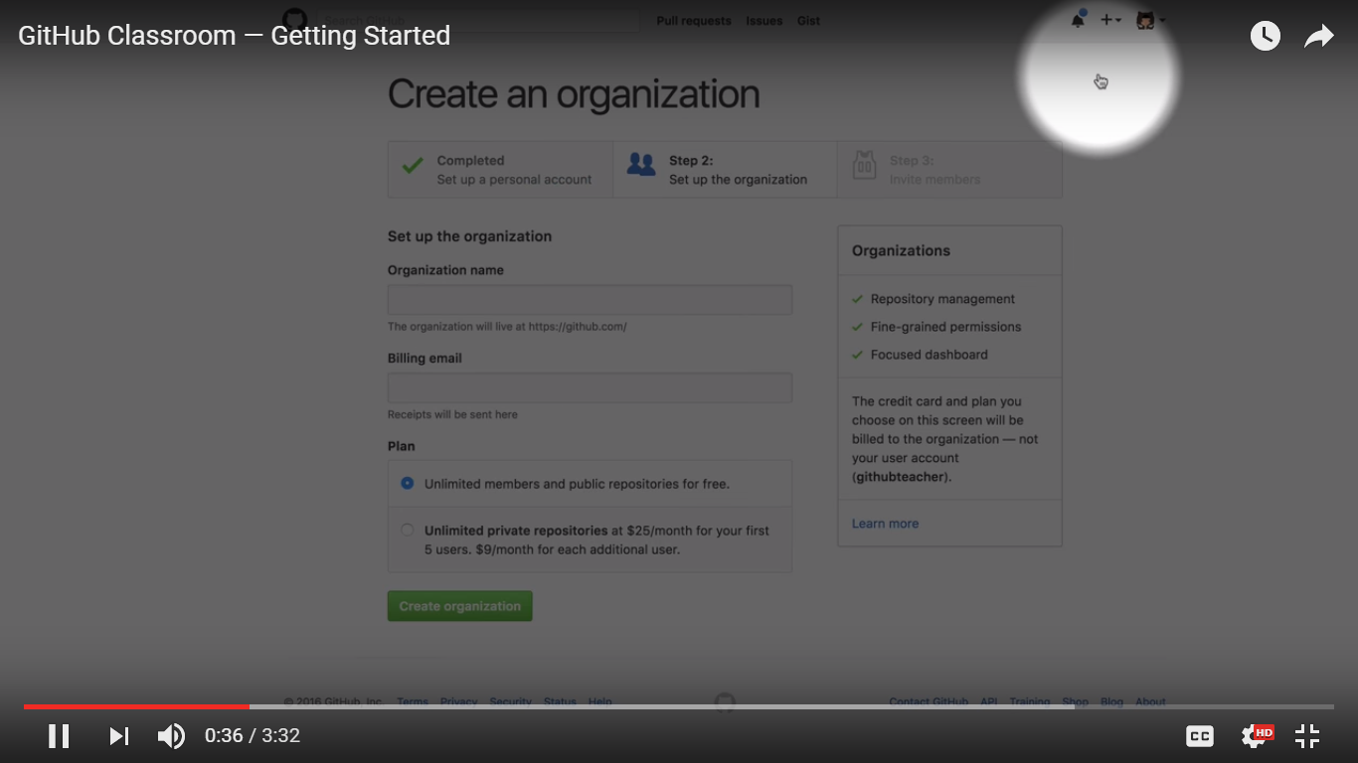
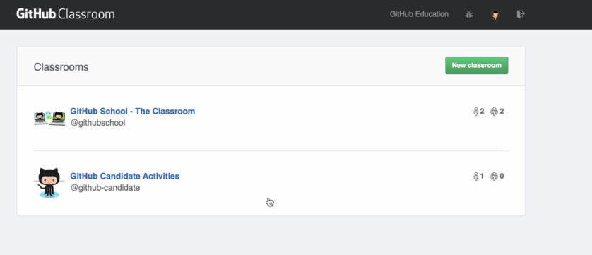

Slide 18
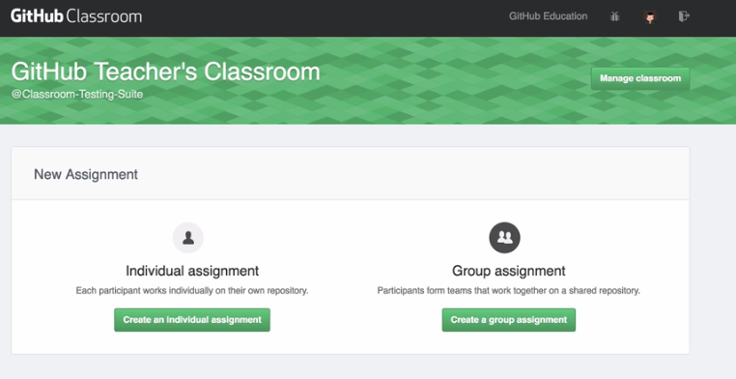
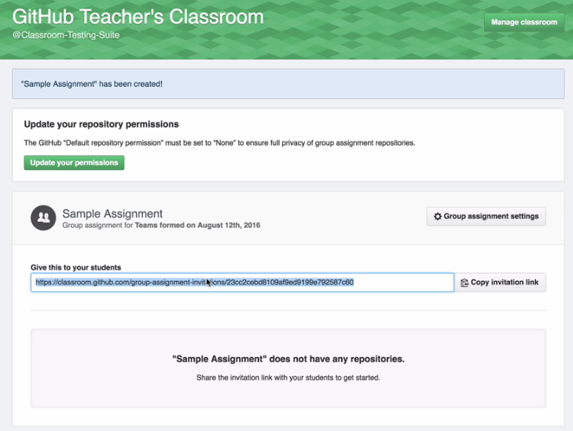

Slide 19
It’s Time for HANDS-on LAB

